Slide 1
Assignment – Dashboard Creation
Submitted By: Pooran Pragnya
November Batch (BDS)

Slide 2
Dashboard
A dashboard is a type of graphical user interface which often provides at a glance views of key performance indicators relevant to a particular objective or business process.
It gives a graphical summary of various pieces of important information, typically used to give an overview of a business.
They are created to display multiple worksheets at once, and make them interact with one another.

Slide 3
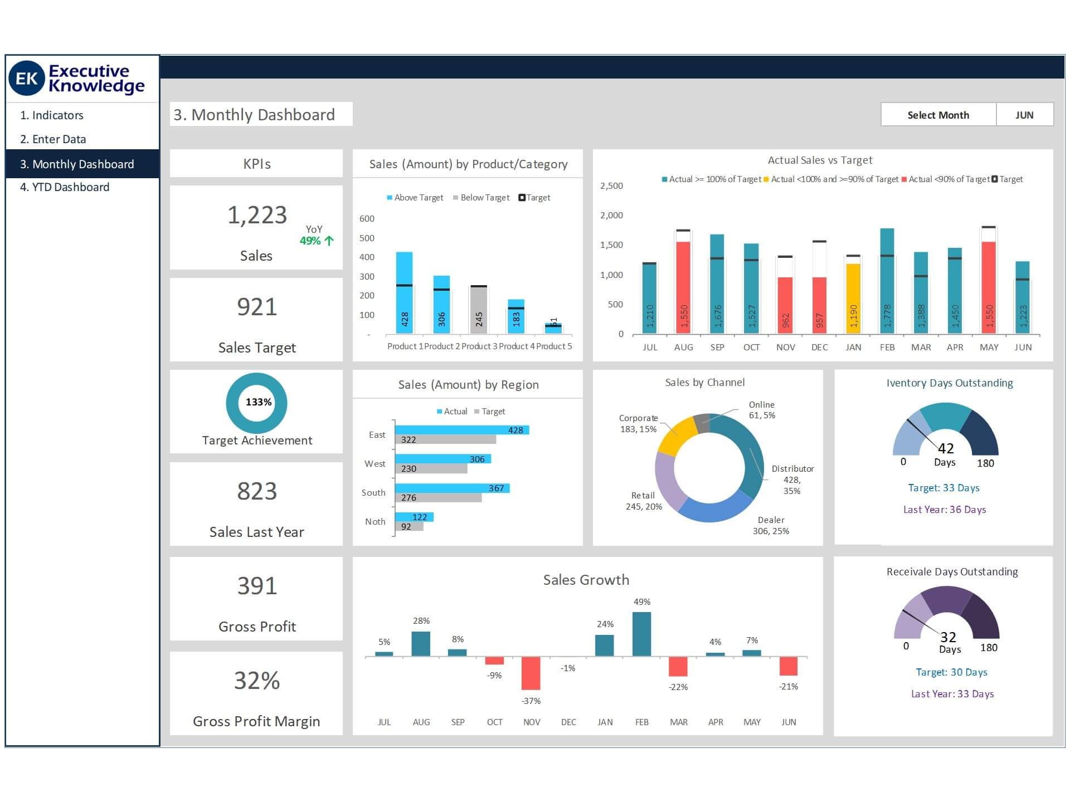

Slide 4
Scenarios:
Build a dashboard to show some insights
Arrange the dashboard
Remove the subcategory filter option to vacate the space.
Remove the year of order filter option to vacate the space.
Select the profit color legend and drag it below to sales in the south.
Make your dashboard interactive

Slide 5
7. Make the order date filter applicable for sales in the south visual as well.
8. One by one check all the states in the profit map having negative profit and check both profit and sales for each state.
9. Rename the dashboard and save as regional sales and profit.

Slide 6
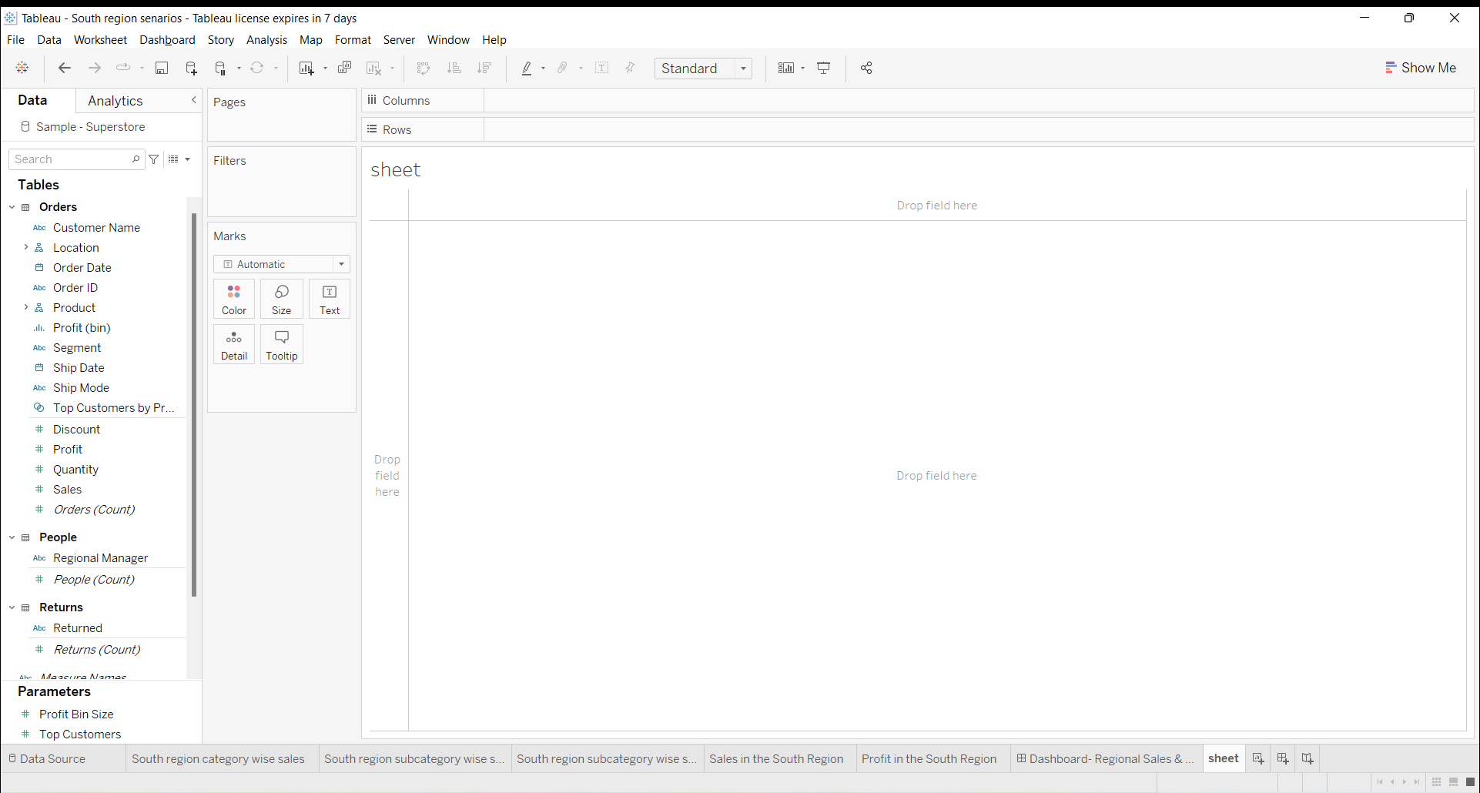
1. Build a dashboard to show some insights

Slide 7
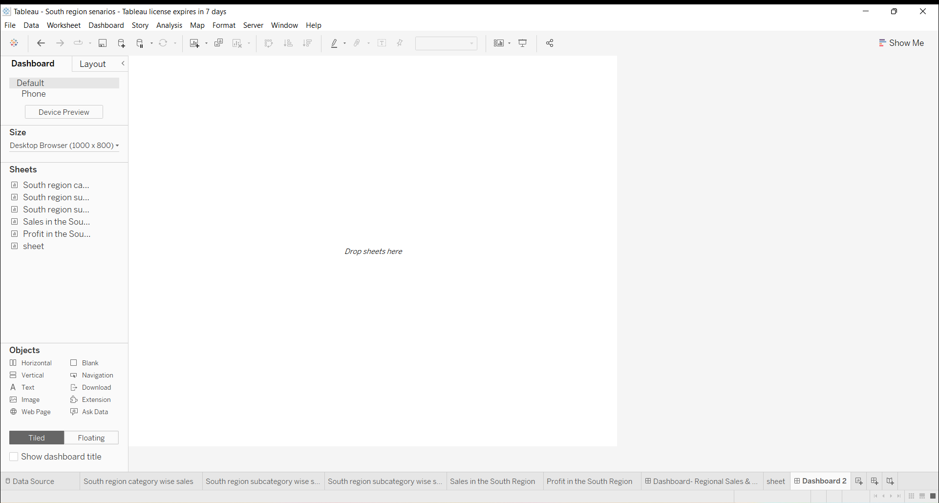

Slide 8
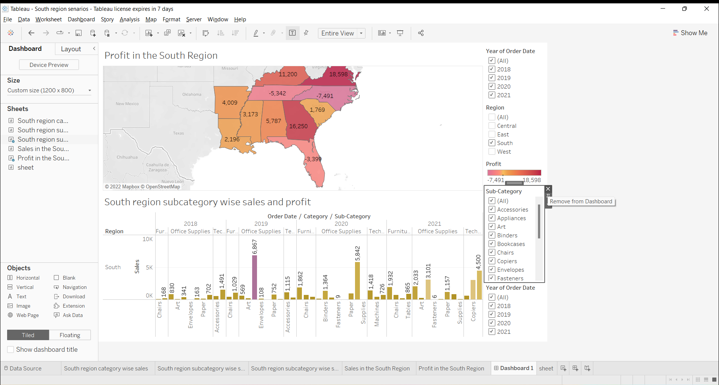

Slide 9
2. Arrange the Dashboard

Slide 10
3. Remove the subcategory filter option to vacate the space

Slide 11
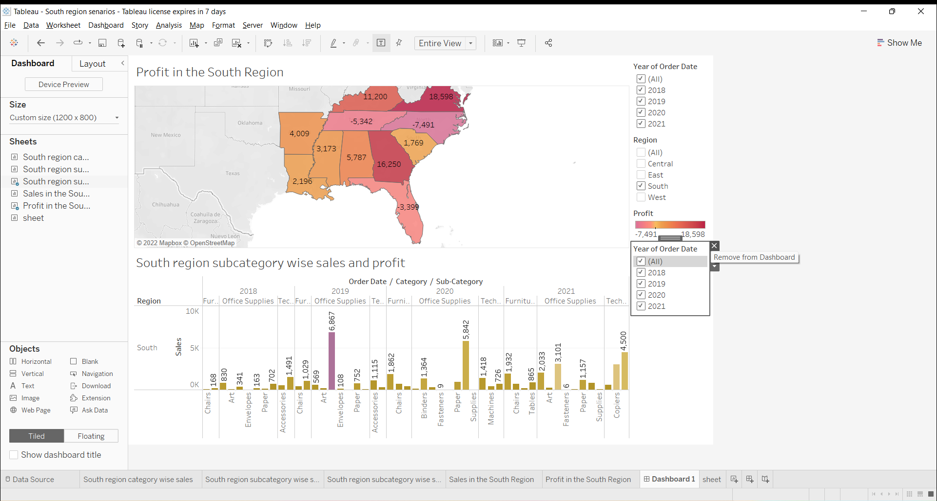
4. Remove the year of order filter option to vacate the space.

Slide 12
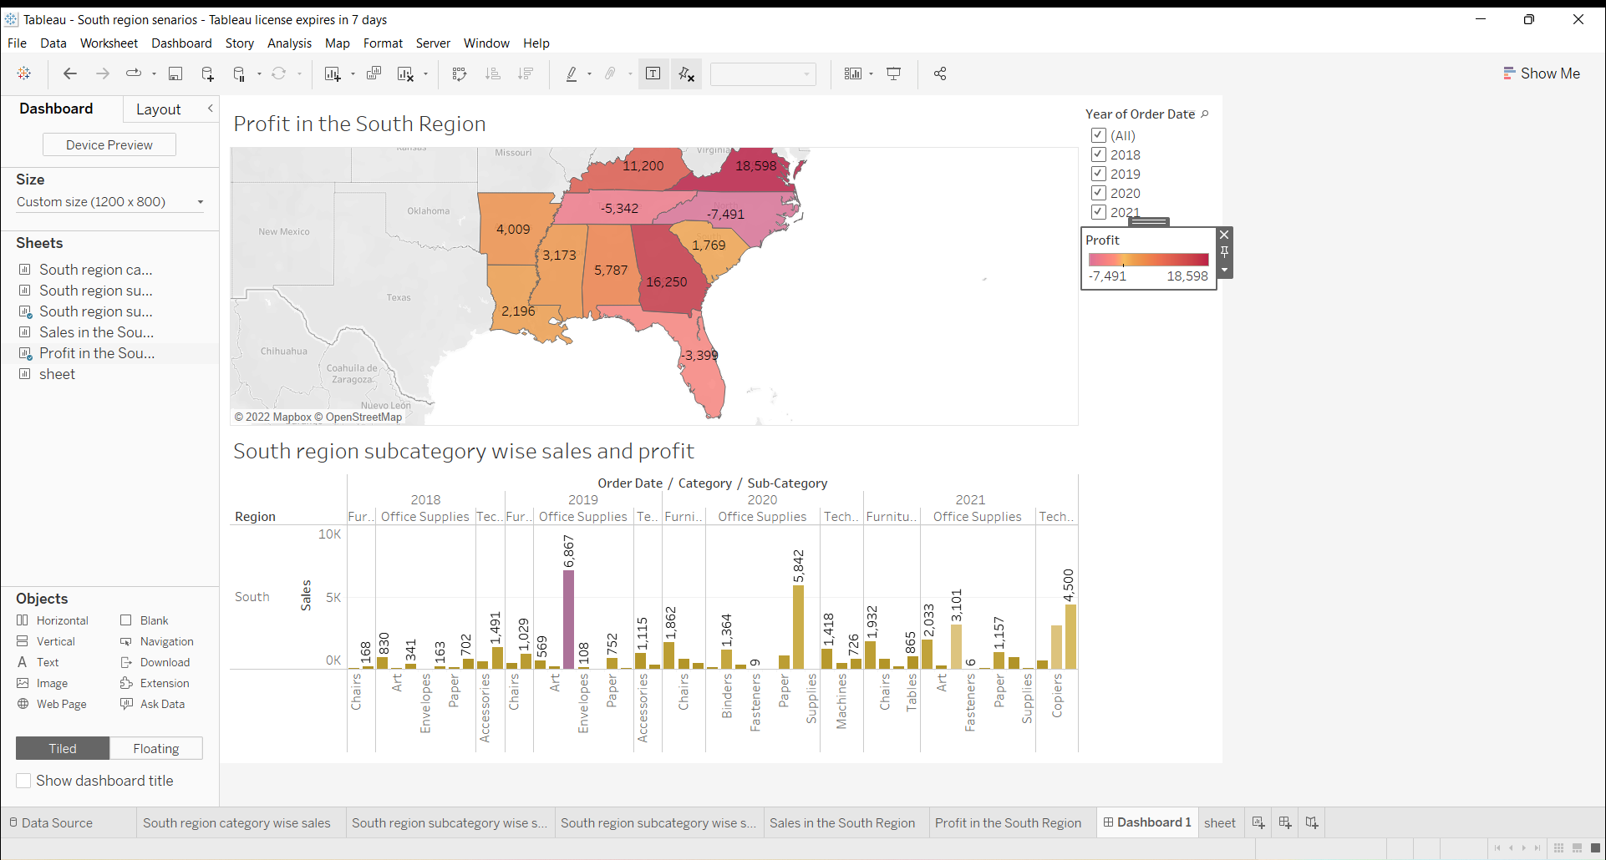
5. Select the profit color legend and drag it below to sales in the south

Slide 13
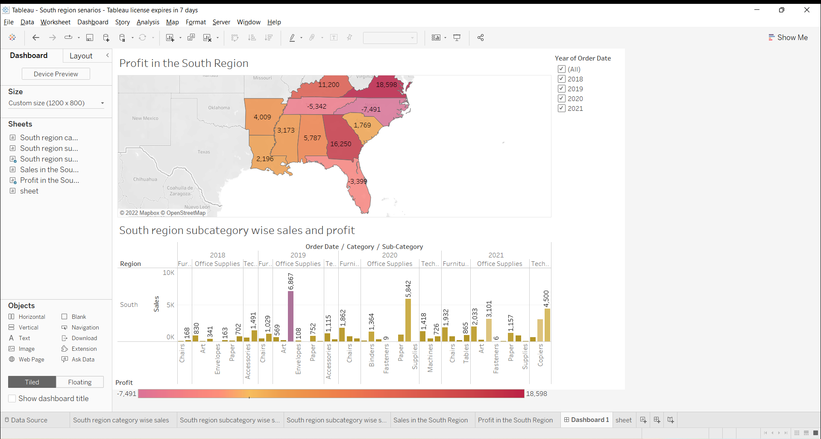

Slide 14
6. Make the order date filter applicable for sales in the south visual as well

Slide 15
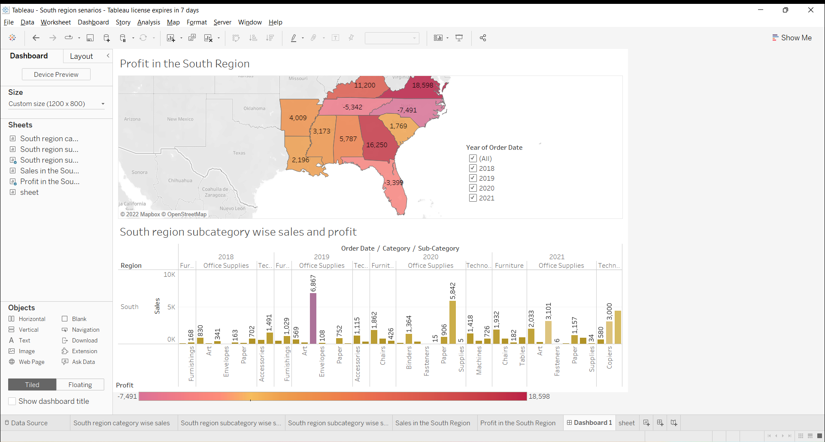

Slide 16
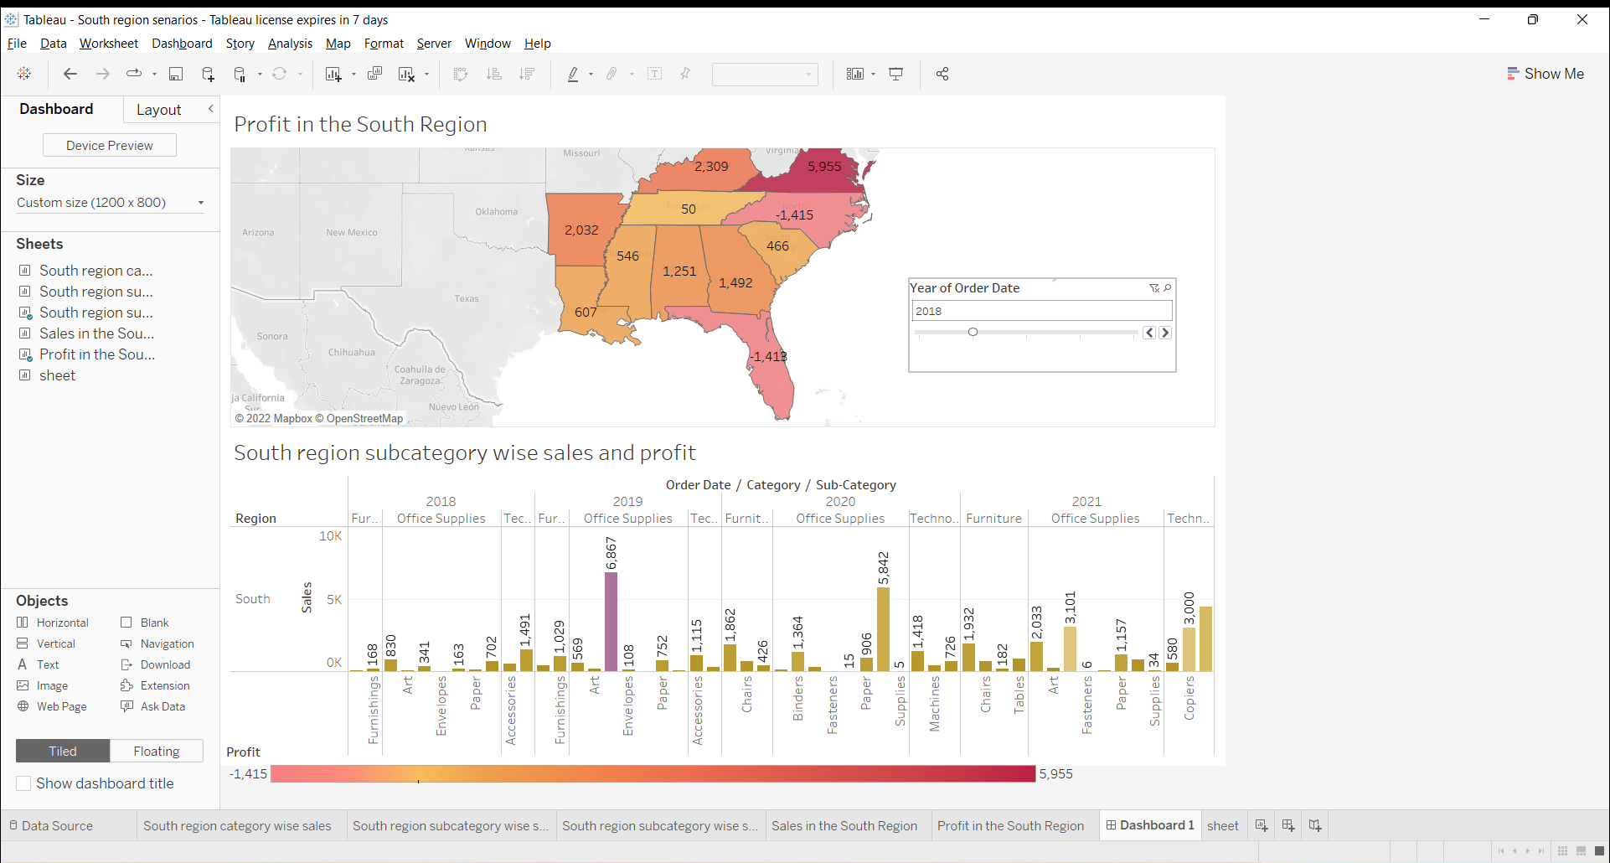

Slide 17
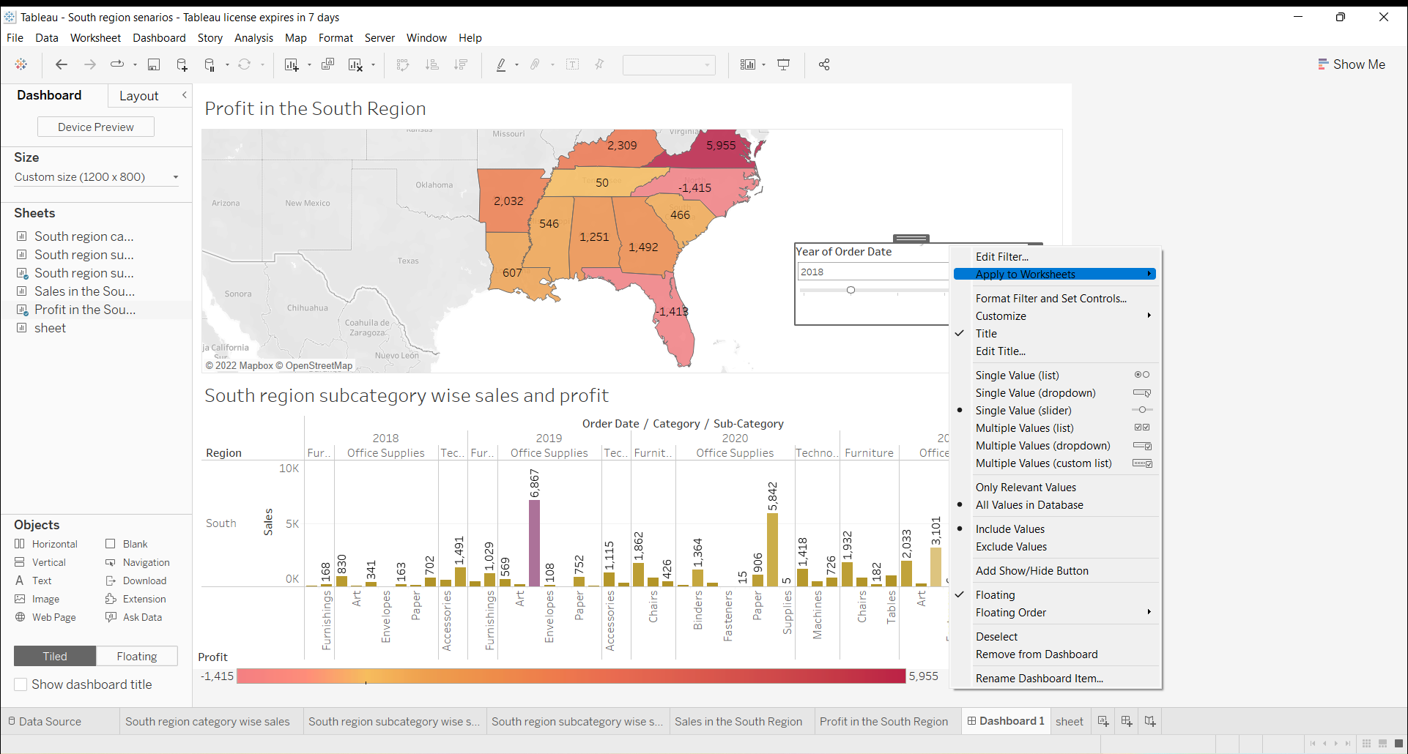

Slide 18
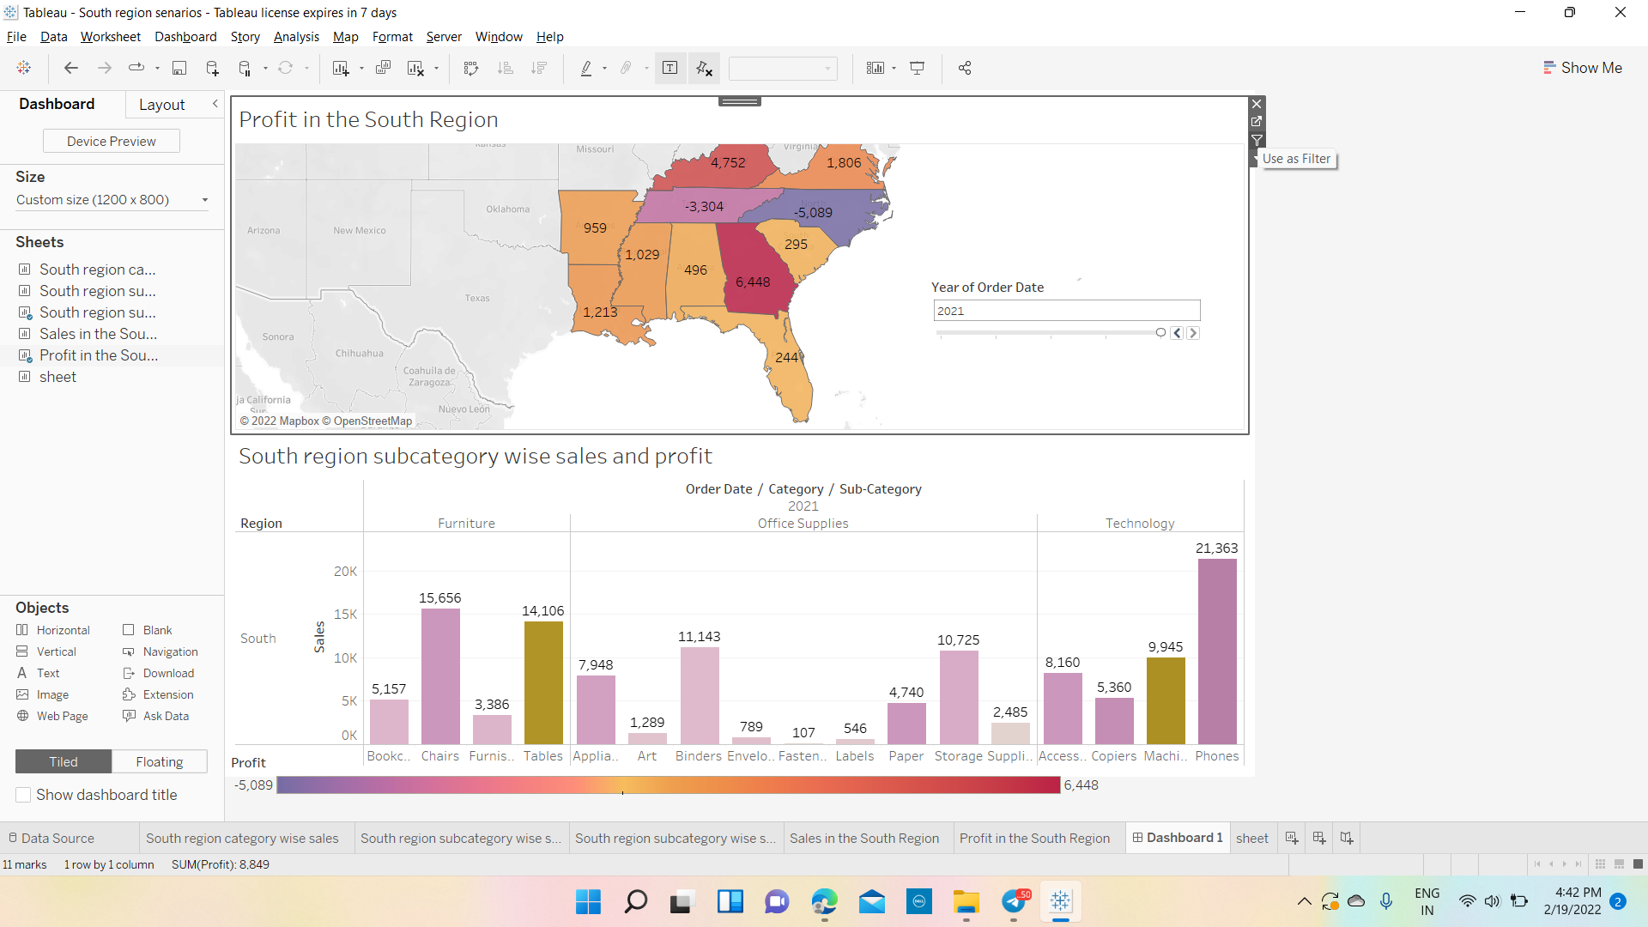
7. Make the dashboard interactive

Slide 19
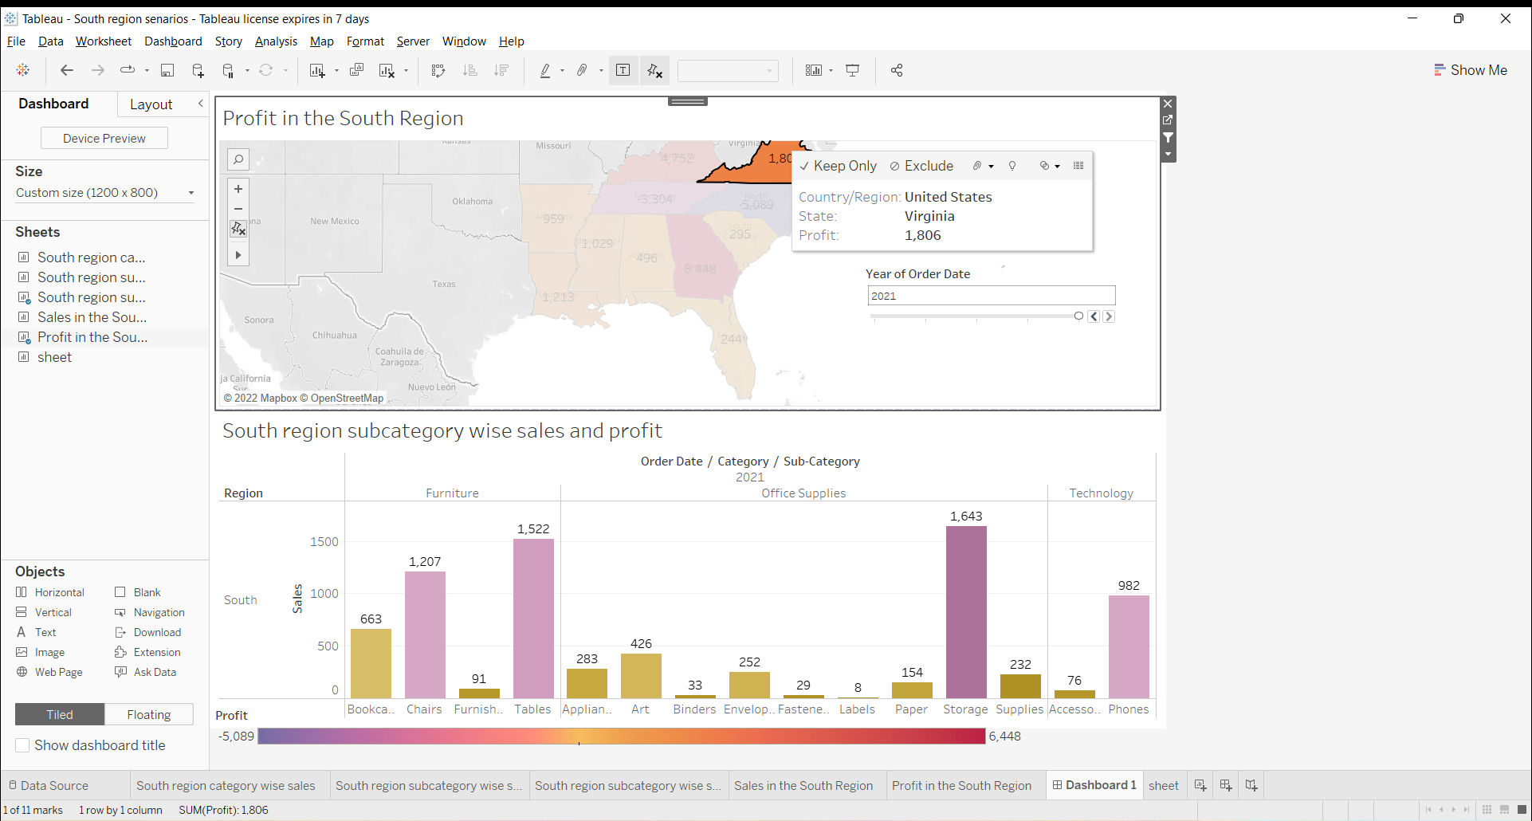

Slide 20
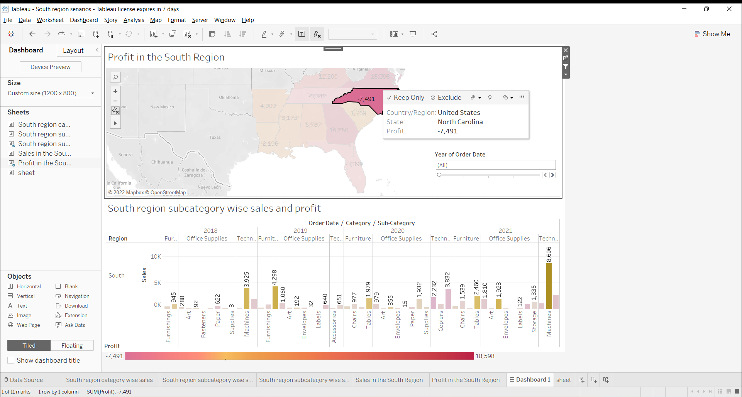
8. One by one click all the states in the profit map having negative profit and check both profit and sales for each state

Slide 21
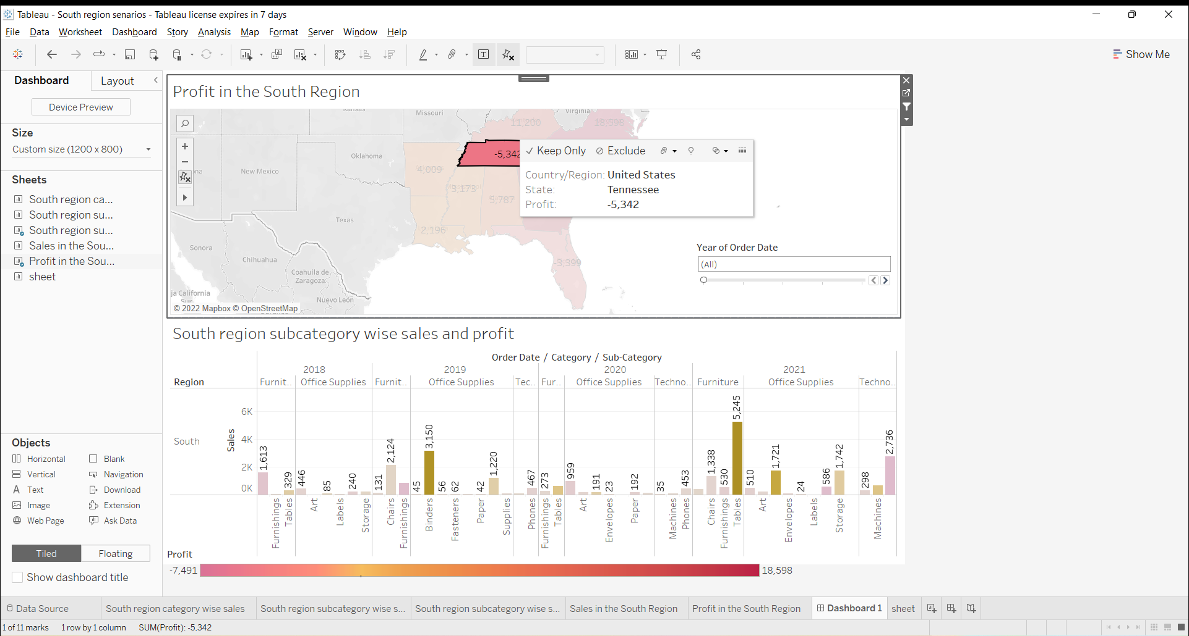

Slide 22
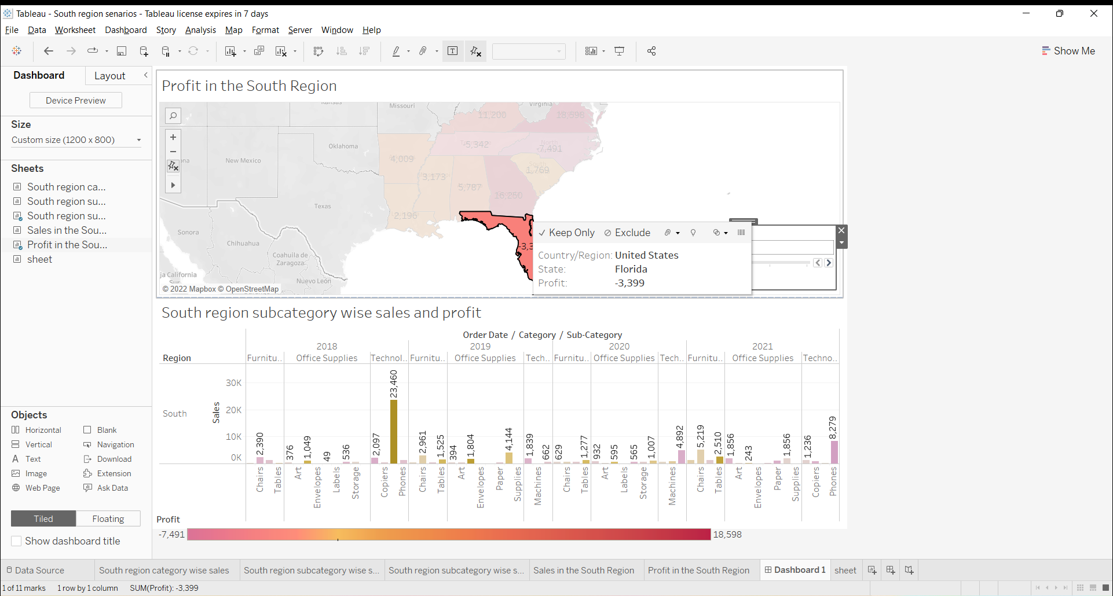

Slide 23
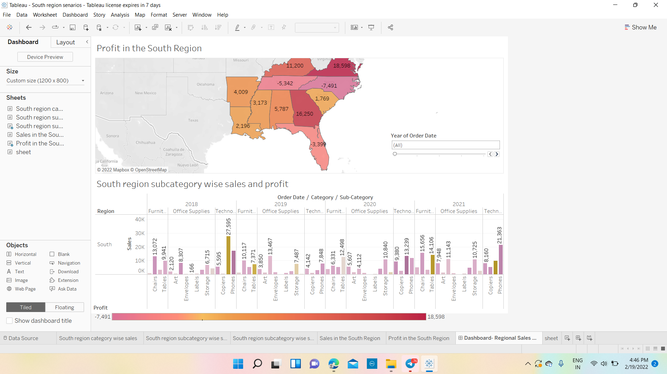
9. Rename the dashboard and save as ‘Regional Sales and Profit’

Slide 24
